Slide 1


BLOCKCHAIN MEETUP
102

Slide 2
Introduction to Blockchain?
1
Introduction to Blockchain
2
Lets continue from Meetup 101
AGENDA
3
Exploring Hyperledger Fabric
4
Application Demo

Slide 3
BLOCKCHAIN INTRODUCTION

Slide 4
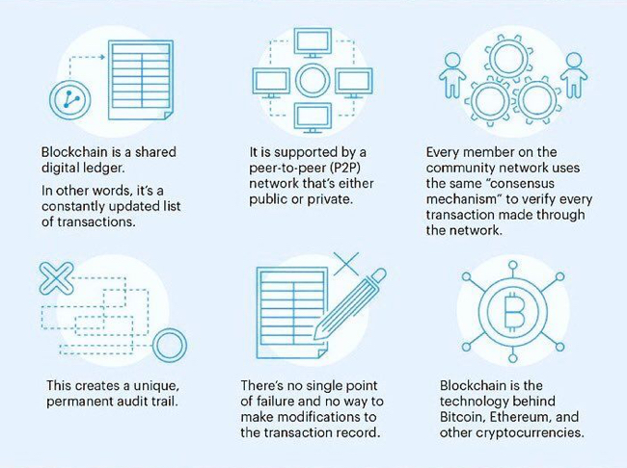
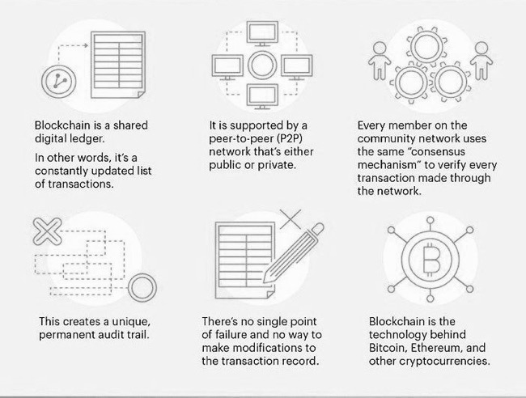
WHAT IS BLOCKCHAIN

Slide 5
BLOCKCHAIN MEETUP 101

Slide 6
WHAT WE COVERED IN MEETUP 101
Blockchain History
Key components and Key concepts
Blockchain Vs Centralized DB
What Business problems Blockchain can solve

Slide 7


HOW BLOCKS ARE FORMED
Previous Block (N -1) Signature/Hash
Block N
Block N + 1
Previous Block (N) Signature/Hash
Transaction/ Ledger
Abc
Digital Certificate
10110111
123
Digital Certificate
10000011
Wert
Digital Certificate
10011011
10110101000111011
101010101010111
Salt / Nonce
Block Signature/Hash
Salt / Nonce

Slide 8




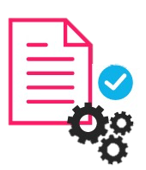

Shared ledger
Cryptography
Append-only distributed system of record shared across business network
Ensuring secure, authenticated and verifiable transactions
KEY CONCEPTS & FEATURES
Consensus
Smart Contracts
All parties agree to network verified transaction
Business terms embedded in transaction database & executed with transactions
Digital Certificates
Hashing
Peer to peer network
Validation by consensus
Immutability
Information distributed and replicated
Unforgeable Traceability
Chain Grouping
Type- Private, Public & Permissioned
Notes:
Shared Ledger
Ledger is record keeping file which store the transactions one after another. And Shared ledger is a general agreement of replicated, shared, and synchronized digital data geographically spread across multiple locations. There is no central administrator or centralised data storage. Using a peer-to-peer network ledger replication across nodes is undertaken.
Peers
They are the nodes in the peer-to-peer network, who participate in the network decisions, like broad casting the messages to other peers, approve/reject consensuses. Creating transactions passing them to Orderer, running smart contracts etc.
Miners / Orderer
They are responsible for collecting the transactions, validate them using defined endorsement policies, and rearranging them in block, creating block and broad casting these blocks to other peer nodes.
Consensus
It is general agreement between peers, how to agree upon the new transaction/ ledgers to accepted in system.

Slide 9
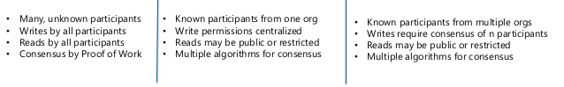
TYPES OF BLOCKCHAIN NETWORK
Public Ledger
Private Ledger
Hybrid Ledger

Slide 10
Hyperledger Fabric

Slide 11
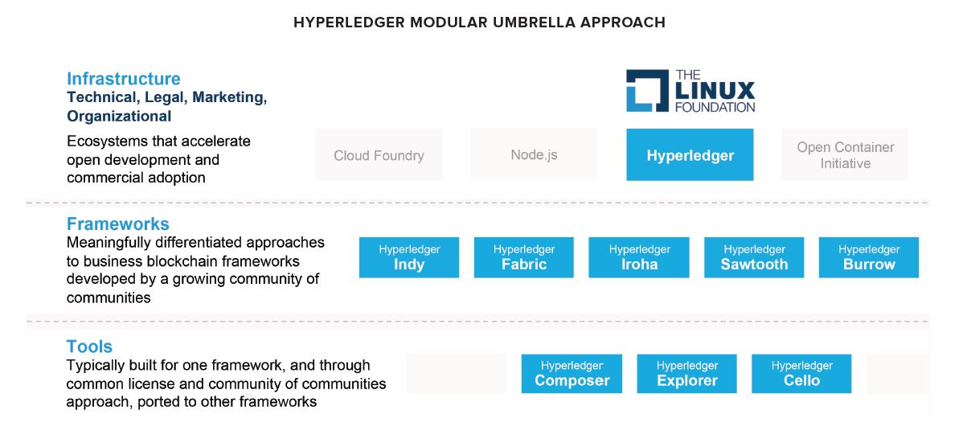

Slide 12
KEY CONCEPTS OF HYPERLEDGER FABRIC
Peer
Validators
Orderer
Domain / Business Network
CA
Organization
World State
Smart Contracts
Channels

Slide 13
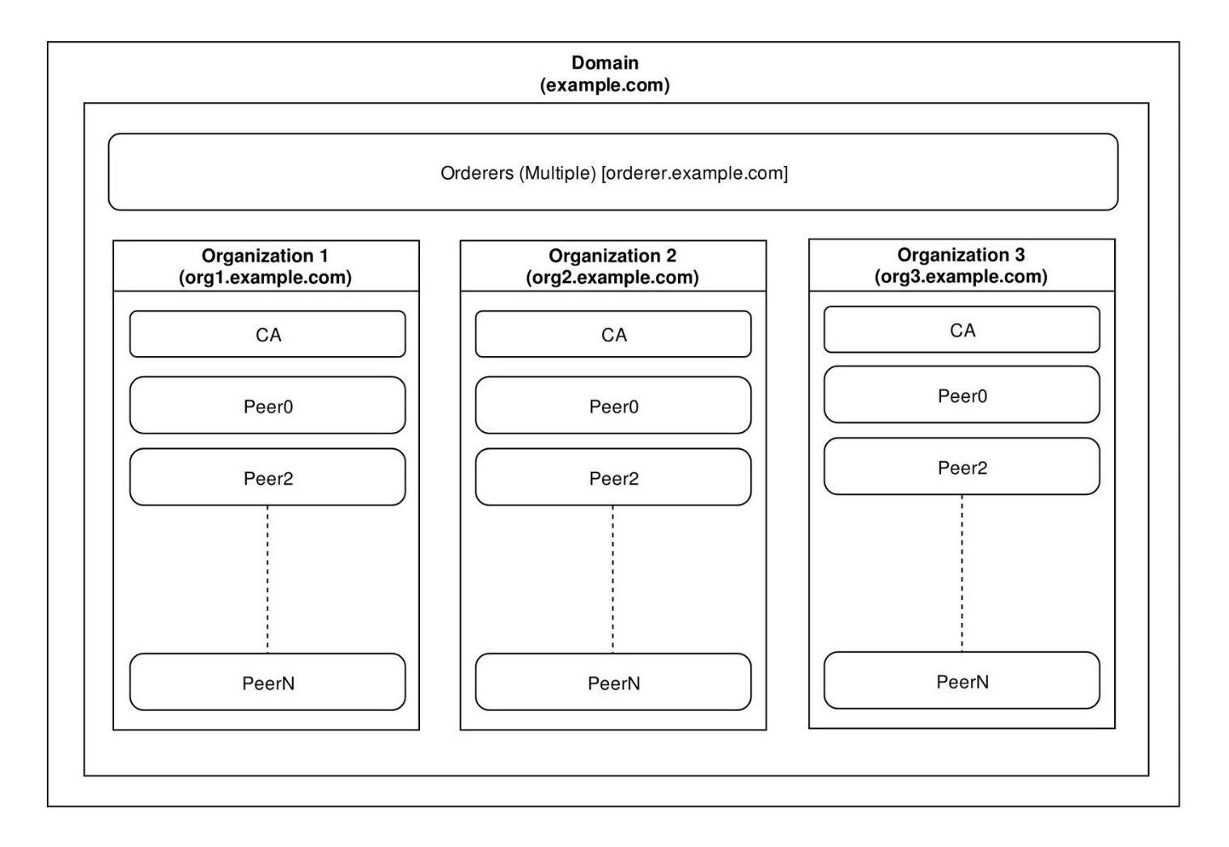
Hyperledger
Fabric
Architecture

Slide 14
Transaction flow:
Transaction flow is discussed in detail
http://hyperledger-fabric.readthedocs.io/en/release/txflow.html
Scenarios like double spending, how basic transaction guarantee with enterprise level throughput is supported is explored.

Slide 15
Composer:
Composer installation and basic commands to deploy business network over Hyperledger network.
https://hyperledger.github.io/composer/latest/installing/development-tools
Architecture of the Business Network application, various files involved.
https://hyperledger.github.io/composer/tutorials/deploy-to-fabric-single-org.html

Slide 16
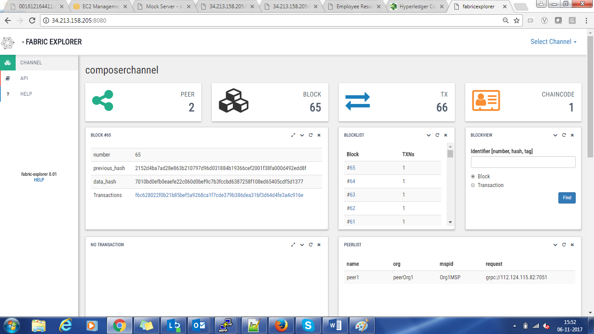
Hyperledger Explorer: Saw chain code, channel, transaction, blocks in Hyperledger explorer.

Slide 17

OPEN MIC

Slide 18

BLOCKCHAIN WEBINAR 102
9th Feb, 2018
NISHIKANT NIPANE
SWAGATA GUPTA
AMIT UKIRADE
(C) Parkar Consulting LLC 2017 Confidential & Proprietary

